Slide 1
Planning in the Continuous Domain: a Generalized
Belief Space Approach for Autonomous Navigation in
Unknown Environments
Vadim Indelman, Luca Carlone , and Frank Dellaert
International Journal of Robotics Research - 2015
Indelman, V., Carlone, L., and Dellaert, F. (2013). Towards planning in generalized belief space. In Proc. of the Intl. Symp. of Robotics Research (ISRR).
Indelman, V., Carlone, L., and Dellaert, F. (2014). Planning under uncertainty in the continuous domain: a generalized belief space approach. In IEEE Intl. Conf. on Robotics and Automation (ICRA).
Dan and Alon

Slide 2
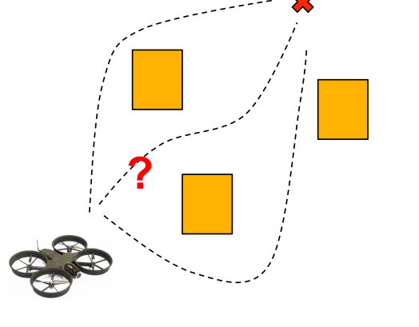
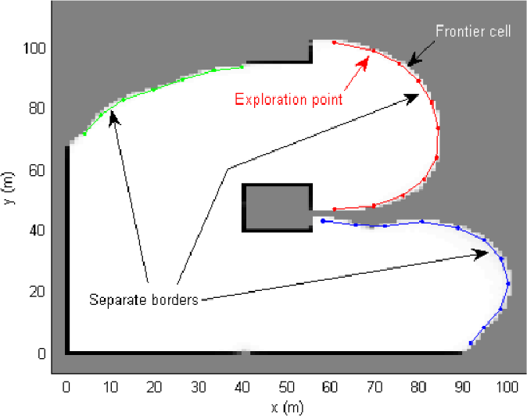
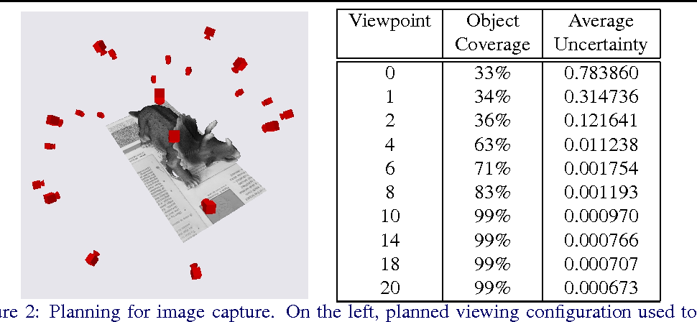
Problem Statement
Formulate a general strategy to accomplish common tasks in robotics in the following setting:
No prior knowledge
Continuous Domain (as opposed to discrete)
Maximum Likelihood Observations
Path Planning
Exploration
Next Best View

Slide 3
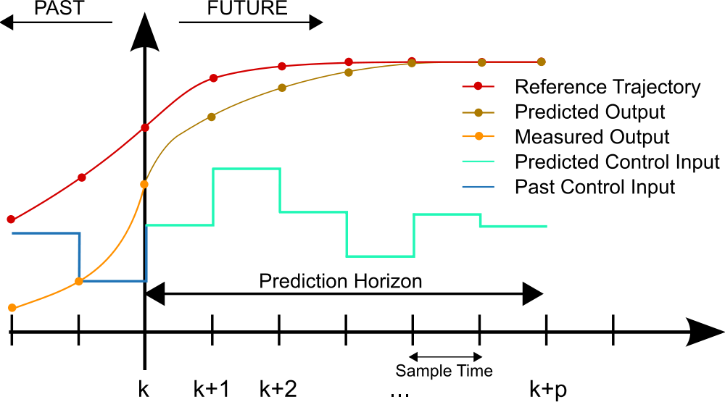
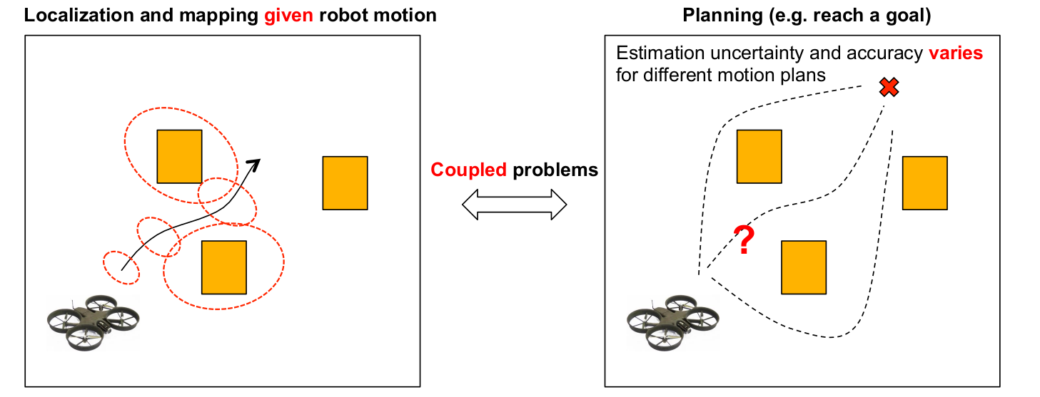
Approach:
Model Predictive Controller
Plan with the Estimation in mind

Slide 4
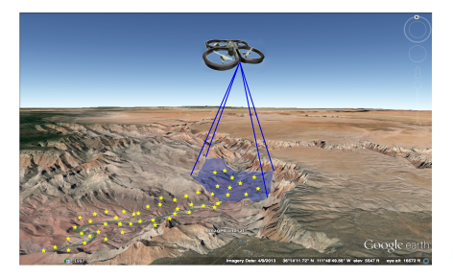
Motivating Example Used:
UAV flies over an unknown region with a camera looking downwards.
Its goal is to reach pre-specified goal positions while preserving an acceptable localization error
Notes:
UAV in an unknown

Slide 5
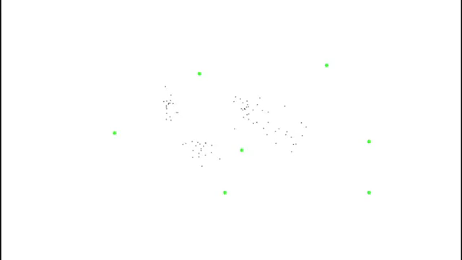

Slide 6
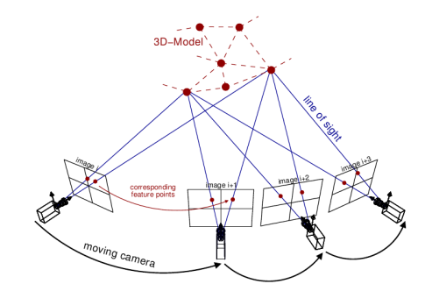
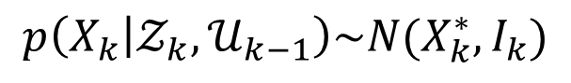
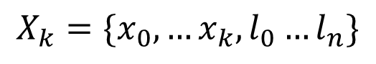
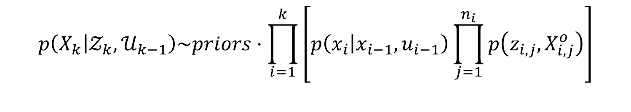
Plan with Estimation in Mind:
As the environment is unknown, a joint state vector is held:
$$X_{k}=\{x_{0},…x_{k},l_{0}…l_{n}\}$$
robot poses
landmarks
Estimation over the joint probability:
$$p\left(X_{k} | 𝒵_{k},𝒰_{k−1}\right)\sim priors⋅\prod_{i=1}^{k}{\left[p\left(x_{i} | x_{i−1},u_{i−1}\right)\prod_{j=1}^{n_{i}}{p\left(z_{i,j},X_{i,j}^{o}\right)}\right]}$$
Motion model
Observation model
Architect models such that the posterior can be modeled as a gaussian:
$$p\left(X_{k} | 𝒵_{k},𝒰_{k−1}\right)\sim N(X_{k}^{∗},I_{k})$$
Information Matrix

Slide 7
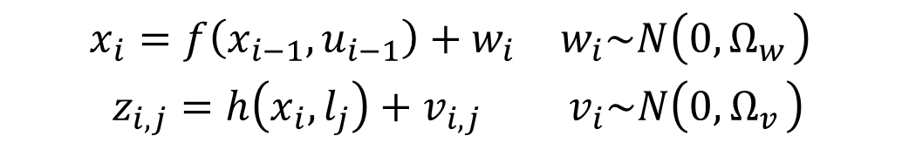
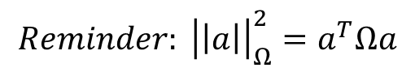
Solving for the posterior distribution via Expectation Maximization:
$$X_{k}^{∗}=\underset{X_{k}}{argmax} p\left(X_{k} | 𝒵_{k},𝒰_{k−1}\right)=\underset{X_{k}}{argmin}\left\{−\log\left(p\left(X_{k} | 𝒵_{k},𝒰_{k−1}\right)\right)\right\}$$
$$\begin{matrix}x_{i}=f\left(x_{i−1},u_{i−1}\right)+w_{i} & w_{i}\sim N\left(0,Ω_{w_{ }}\right) \\ z_{i,j}=h\left(x_{i},l_{j}\right)+v_{i,j} & v_{i}\sim N\left(0,Ω_{v_{ }}\right)\end{matrix}$$
$$X_{K}^{∗}=\underset{X_{k}}{argmin} \left\{{\left|\left|x−{\hat{x}}_{0}\right|\right|}_{Ω_{0}}^{2}+\sum_{i}{\left[{\left|\left|x_{i}−f\left(x_{i−1},u_{i−1}\right)\right|\right|}_{{Ω_{w}}_{i}}^{2}+\sum_{j=ℳ_{i}}{{\left|\left|z_{i,j}−h\left(x_{i},l_{j}\right)\right|\right|}_{{Ω_{v}}_{i,j}}^{2}}\right] }\right\}$$
Prior
Motion Models
Observation models
$$Reminder: {\left|\left|a\right|\right|}_{Ω}^{2}=a^{T}Ωa$$

Slide 8

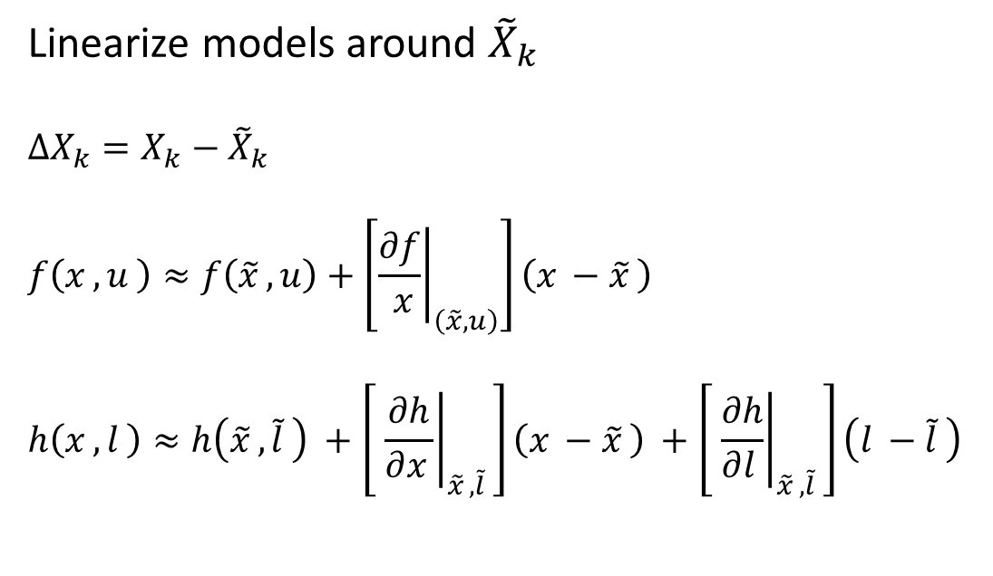
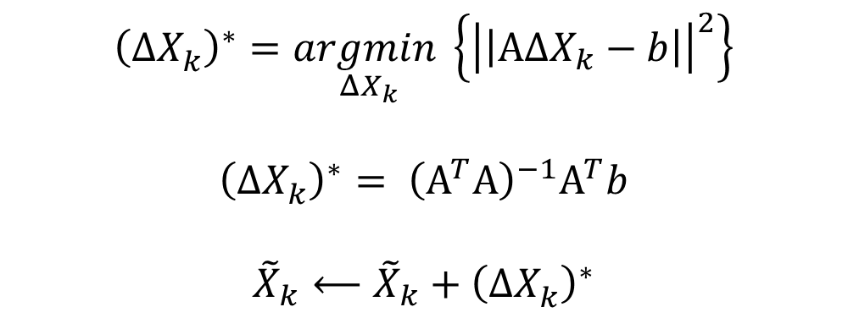
Solving for the posterior distribution via Expectation Maximization:
$$X_{K}^{∗}=\underset{X_{k}}{argmin} \left\{{\left|\left|x−{\hat{x}}_{0}\right|\right|}_{Ω_{0}}^{2}+\sum_{i}{\left[{\left|\left|x_{i}−f\left(x_{i−1},u_{i−1}\right)\right|\right|}_{{Ω_{w}}_{i}}^{2}+\sum_{j=ℳ_{i}}{{\left|\left|z_{i,j}−h\left(x_{i},l_{j}\right)\right|\right|}_{{Ω_{v}}_{i,j}}^{2}}\right] }\right\}$$
Linearize models around ${\tilde{X}}_{k}$
$$ΔX_{k}=X_{k}−{\tilde{X}}_{k}$$
$$f\left(x_{ },u_{ }\right)≈f\left({\tilde{x}}_{ },u\right)+\left[{\left.\frac{∂f}{ x}\right|}_{\left(\tilde{x}, u\right)}\right]\left(x_{ }−{\tilde{x}}_{ }\right)$$
$$h\left(x_{ },l_{ }\right)≈h\left({\tilde{x}}_{ },{\tilde{l}}_{ }\right) +\left[ {\left.\frac{∂h}{∂x_{ }}\right|}_{{\tilde{x}}_{ },{\tilde{l}}_{ }}\right]\left(x_{ }−{\tilde{x}}_{ }\right) +\left[ {\left.\frac{∂h}{∂l_{ }}\right|}_{{\tilde{x}}_{ },{\tilde{l}}_{ }}\right]\left(l_{ }−{\tilde{l}}_{ }\right)$$
$${\left(ΔX_{k}^{ }\right)}^{∗}=\underset{ΔX_{k}}{argmin}\left\{{\left|\left|ΑΔX_{k}−b\right|\right|}^{2}\right\}$$
$${\left(ΔX_{k}^{ }\right)}^{∗}= {\left(Α^{T}Α\right)}^{−1}Α^{T}b$$
$${\tilde{X}}_{k}⟵{\tilde{X}}_{k}+{\left(ΔX_{k}^{ }\right)}^{∗}$$
Do this until convergence

Slide 9
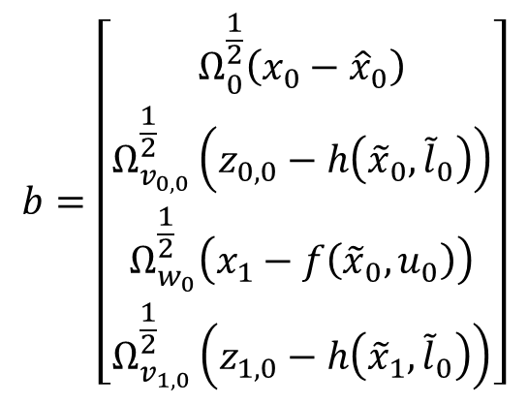
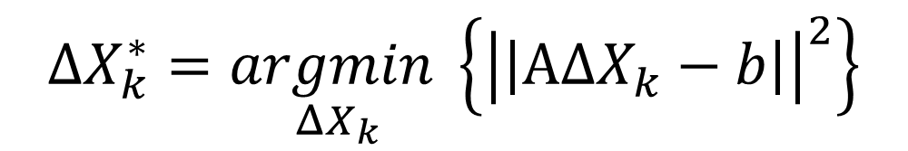
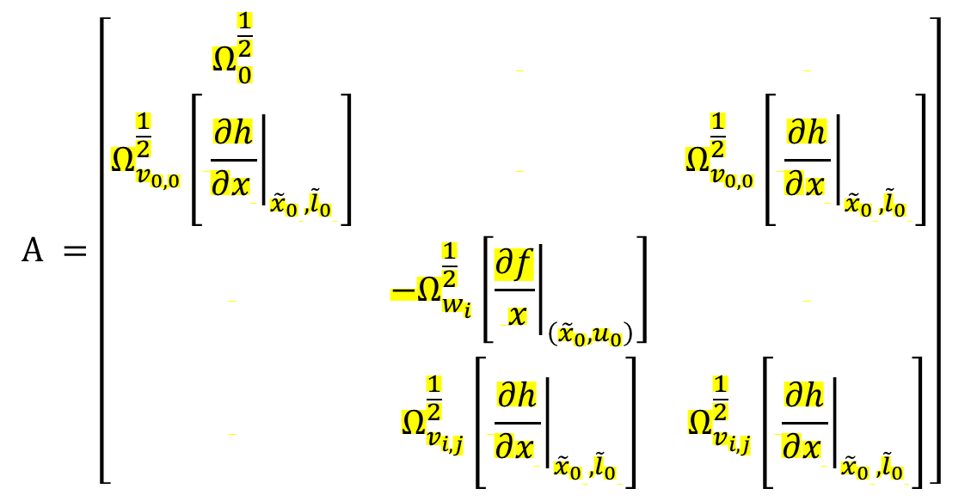
Solving for the posterior distribution via Expectation Maximization:
$$ΔX_{k}^{∗}=\underset{ΔX_{k}}{argmin}\left\{{\left|\left|ΑΔX_{k}−b\right|\right|}^{2}\right\}$$
$$Α =\left[\begin{matrix}Ω_{0}^{\frac{1}{2}} & & \\ Ω_{v_{0,0}}^{\frac{1}{2}}\left[ {\left.\frac{∂h}{∂x_{ }}\right|}_{{{\tilde{x}}_{0}}_{ },{{\tilde{l}}_{0}}_{ }}\right] & & Ω_{v_{0,0}}^{\frac{1}{2}}\left[ {\left.\frac{∂h}{∂x_{ }}\right|}_{{{\tilde{x}}_{0}}_{ },{{\tilde{l}}_{0}}_{ }}\right] \\ & −Ω_{w_{i}}^{\frac{1}{2}}\left[{\left.\frac{∂f}{ x}\right|}_{\left({\tilde{x}}_{0}, u_{0}\right)}\right] & \\ & Ω_{v_{i,j}}^{\frac{1}{2}}\left[ {\left.\frac{∂h}{∂x_{ }}\right|}_{{{\tilde{x}}_{0}}_{ },{{\tilde{l}}_{0}}_{ }}\right] & Ω_{v_{i,j}}^{\frac{1}{2}}\left[ {\left.\frac{∂h}{∂x_{ }}\right|}_{{{\tilde{x}}_{0}}_{ },{{\tilde{l}}_{0}}_{ }}\right]\end{matrix}\right]$$
$$b=\left[\begin{matrix}Ω_{0}^{\frac{1}{2}}\left(x_{0}−{\hat{x}}_{0}\right) \\ Ω_{v_{0,0}}^{\frac{1}{2}}\left(z_{0,0}−h\left({\tilde{x}}_{0},{\tilde{l}}_{0}\right)\right) \\ Ω_{w_{0}}^{\frac{1}{2}}\left(x_{1}−f\left({\tilde{x}}_{0},u_{0}\right)\right) \\ Ω_{v_{1,0}}^{\frac{1}{2}}\left(z_{1,0}−h\left({\tilde{x}}_{1},{\tilde{l}}_{0}\right)\right)\end{matrix}\right]$$
Whitened errors
Whitened Jacobians
Not a function of the measurements (at first iteration)

Slide 10
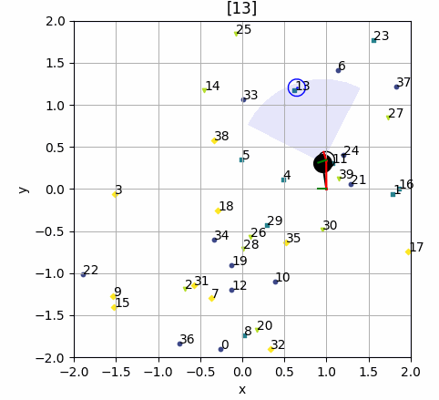
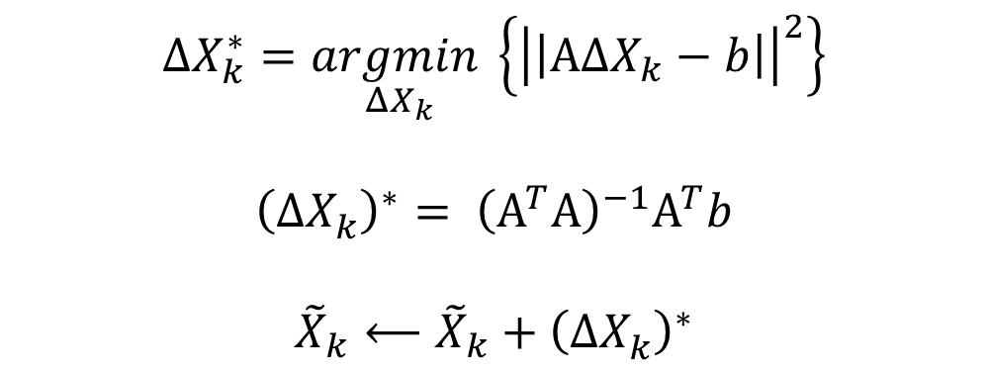
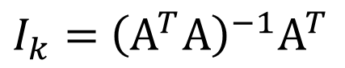
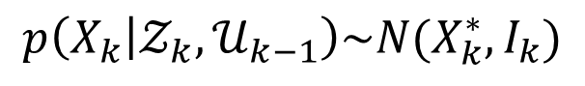
Solving for the posterior distribution via Expectation Maximization:
$$p\left(X_{k} | 𝒵_{k},𝒰_{k−1}\right)\sim N(X_{k}^{∗},I_{k})$$
$$ΔX_{k}^{∗}=\underset{ΔX_{k}}{argmin}\left\{{\left|\left|ΑΔX_{k}−b\right|\right|}^{2}\right\}$$
$${\left(ΔX_{k}^{ }\right)}^{∗}= {\left(Α^{T}Α\right)}^{−1}Α^{T}b$$
$${\tilde{X}}_{k}⟵{\tilde{X}}_{k}+{\left(ΔX_{k}^{ }\right)}^{∗}$$
$I_{k}=$ ${\left(Α^{T}Α\right)}^{−1}Α^{T}$
Do this until convergence

Slide 11
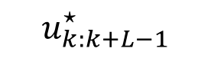
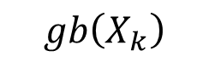
Planning in the Generalized Belief Space
$$gb\left(X_{k}\right)$$
Estimate of future state
$$u_{k:k+L−1}^{⋆}$$
$$gb\left(X_{k}\right)= p\left(X_{k} | 𝒵_{k},𝒰_{k−1}\right)\sim N(X_{k}^{∗},I_{k})$$

Slide 12
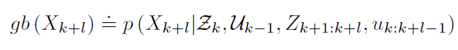
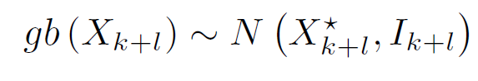
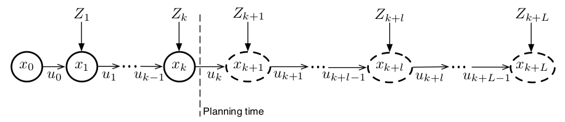
Planning in the Generalized Belief Space
Past
Future

Slide 13
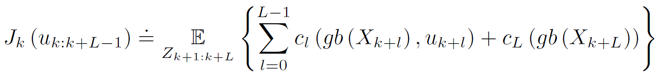

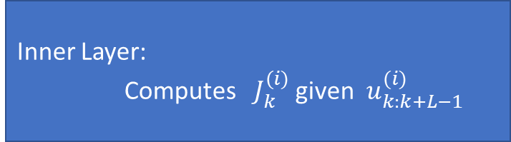
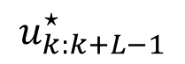
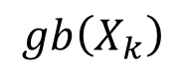
Planning in the Generalized Belief Space
Outer Layer: Updates $u_{k:k+L−1}^{(i+1)}$ given $J_{k}^{(i)}$
Inner Layer:
Computes $J_{k}^{(i)}$ given $u_{k:k+L−1}^{(i)}$
$$u_{k:k+L−1}^{⋆}$$
$$gb\left(X_{k}\right)$$
Notes:
Continuous Action Space:
The machine does not involve searching over the action space, but optimizing over it

Slide 14
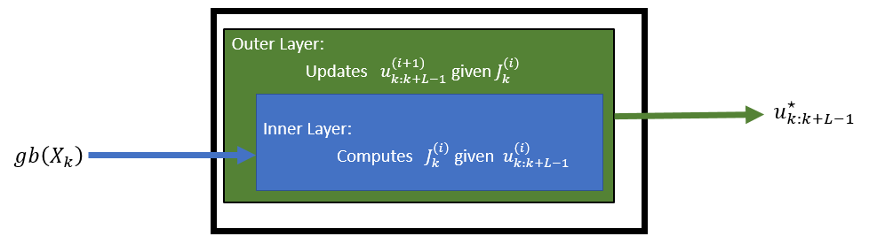
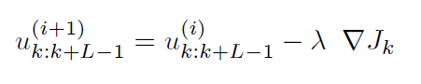

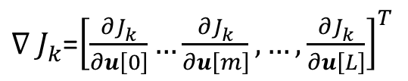
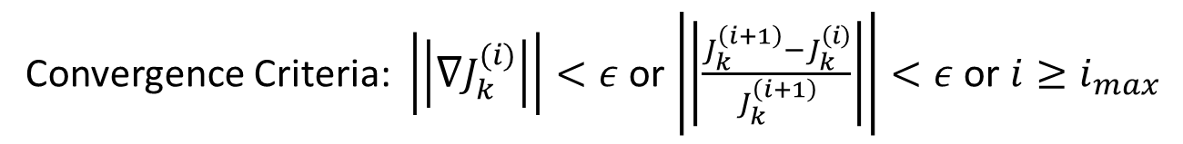
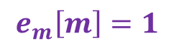

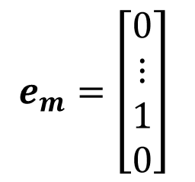
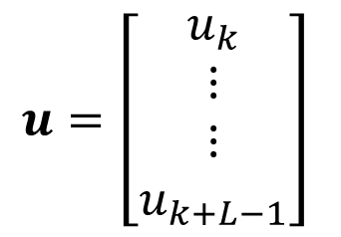
Outer Layer – Inference over the control
Updating via Gradient Decent:
$∇J_{k}$- is the gradient of the objective function
$λ$– suitable step size (positive value)
Convergence Criteria: $\left|\left|∇J_{k}^{(i)}\right|\right|<ε$ or $\left|\left|\frac{J_{k}^{\left(i+1\right)}−J_{k}^{\left(i\right)}}{J_{k}^{\left(i+1\right)}}\right|\right|<ε$ or $i≥i_{max}$
$$\frac{{∂J}_{k}^{ }}{∂u[m]}≈\frac{J_{k}^{ }\left(u+ε⋅e_{m}\right)−J_{k}^{ }\left(u\right)}{ε}$$
$$u=\left[\begin{matrix}u_{k} \\ ⋮ \\ ⋮ \\ u_{k+L−1}\end{matrix}\right]$$
$$e_{m}=\left[\begin{matrix}0 \\ ⋮ \\ 1 \\ 0\end{matrix}\right]$$
$$e_{m}\left[m\right]=1$$
${∇_{ }J}_{k}^{ }$=${\left[\frac{{∂J}_{k}^{ }}{∂u\left[0\right]}…\frac{{∂J}_{k}^{ }}{∂u\left[m\right]},…,\frac{{∂J}_{k}^{ }}{∂u\left[L\right]}\right]}^{T}$
Notes:
(1) The control update is preformed in a continuous domain and can be realized using different optimization techniques. In the paper the method that used is a simple gradient method to compute $u_{k:k+L−1}^{⋆}$.

Slide 15
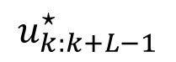
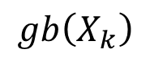

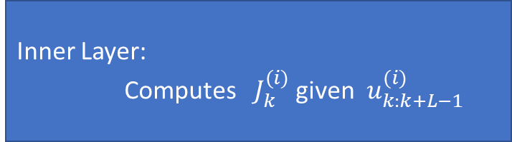
Inner Layer – Inference in GBS
Outer Layer: Updates $u_{k:k+L−1}^{(i+1)}$ given $J_{k}^{(i)}$
Inner Layer:
Computes $J_{k}^{(i)}$ given $u_{k:k+L−1}^{(i)}$
$$u_{k:k+L−1}^{⋆}$$
$$gb\left(X_{k}\right)$$

Slide 16
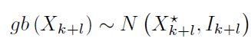
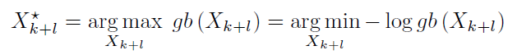
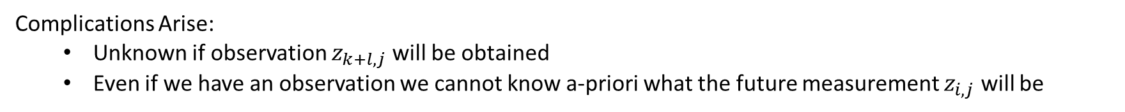

Inner Layer – Inference in GBS
To compute $J_{k}$ we need to infer in the future:
Complications Arise:
Unknown if observation $z_{k+l,j}$ will be obtained
Even if we have an observation we cannot know a-priori what the future measurement $z_{i,j}$ will be
Notes:
The inner layer involve the computation of the Gaussian approximation of:
Whose mean value coincides with the MAP estimate of:

Slide 17
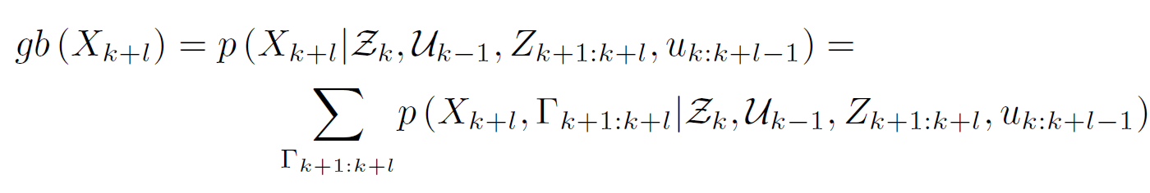
Inner Layer – Inference in GBS
Expectation Maximization (*Minka,1998)
Notes:
The inner layer involve the computation of the Gaussian approximation of:
Whose mean value coincides with the MAP estimate of:

Slide 18
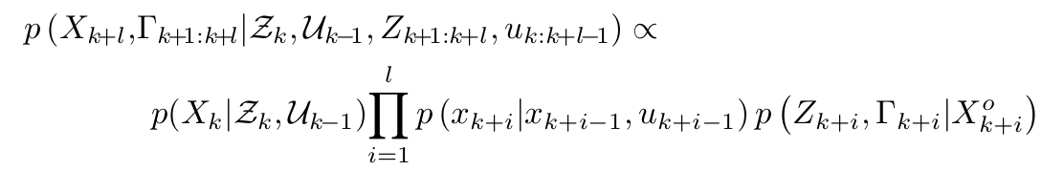
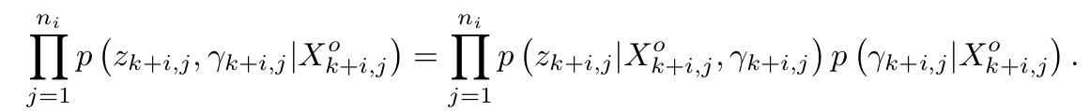
Prior
Motion model
Observation model
Conditioning

Slide 19
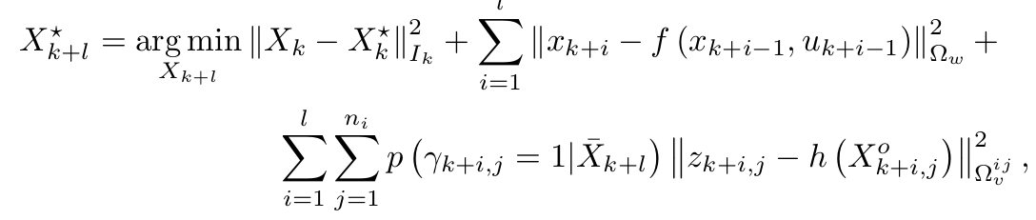
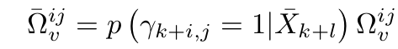
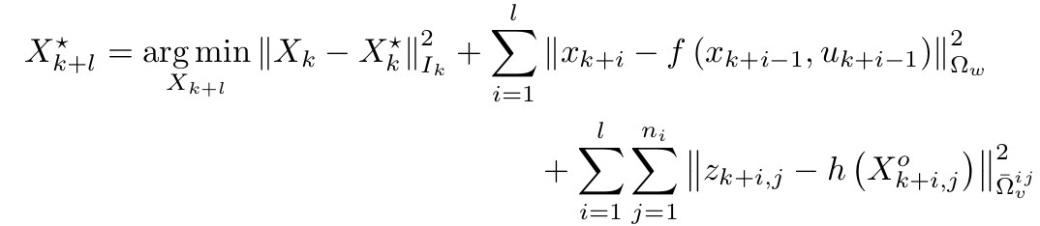

Slide 20

Also serves as linearization point

Slide 21
A specific Family of Objective Functions

Slide 22

A specific Family of Objective Functions
Falls under Maximum Likelihood assumption

Slide 23

A specific Family of Objective Functions

Slide 24



A specific Family of Objective Functions

Slide 25

Naïve approach to choose alpha can result in oscillator behavior.

Slide 26

Experimental Evaluation
Statistical Study (Uniform)
Different Planning Horizons (clusters)
Additional Scenarios

Slide 27

Experimental Evaluation – Statistical Study

Slide 28


Experimental Evaluation – Horizon Length

Slide 29


Experimental Evaluation – Method Comparison
Discrete Planning

Slide 30

Experimental Evaluation - Uniform

Slide 31

Experimental Evaluation - Oasis

Slide 32

Experimental Evaluation - Clusters

Slide 33


Slide 34




Deliberation and Possible Extensions

Slide 35

Deliberation and Possible Extensions

Slide 36


Deliberation and Possible Extensions

Slide 37

Deliberation and Possible Extensions

